Slide 1
SMART PHONE ADDICTION ANALYSIS
Pakiyalakshmi S (9923151063)
Rajapandi N (9923151070)

Slide 2
INTRODUCTION
Widespread Usage: Smartphones are central to daily life, but overuse has led to increasing rates of addiction.
Frequent Checking: Many individuals check their phones hundreds of times a day.
Health Impacts: Excessive screen time is linked to issues such as poor sleep, anxiety, and difficulty concentrating.
Project Focus: This project analyzes smartphone addiction and its impact using data to measure phone dependency.
Interactive Visualization: Tableau dashboards provide an interactive way to explore trends and view data from multiple perspectives.

Slide 3
MOTIVATION
Investigate the growing dependence on smartphones and its impact on mental health, social interactions, and daily routines.
Visualize smartphone usage patterns to identify trends in phone reliance across different activities, including social media, gaming, and content consumption.
Examine correlations between phone usage habits and factors such as mental health, age, and occupation.
Raise awareness about the effects of excessive smartphone usage through clear and impactful data visualizations.

Slide 4
Objectives
Analyze Smartphone Usage Patterns: Examine data on how individuals use their smartphones, including common activities and frequency of use.
Identify Levels of Smartphone Addiction: Assess and categorize varying levels of smartphone addiction across different demographics.
Explore Health Impacts: Investigate correlations between smartphone overuse and mental/physical health issues like anxiety, sleep disturbances, and attention difficulties.
Provide Interactive Visualizations: Use Tableau dashboards to allow users to explore trends in smartphone usage and addiction interactively.

Slide 5
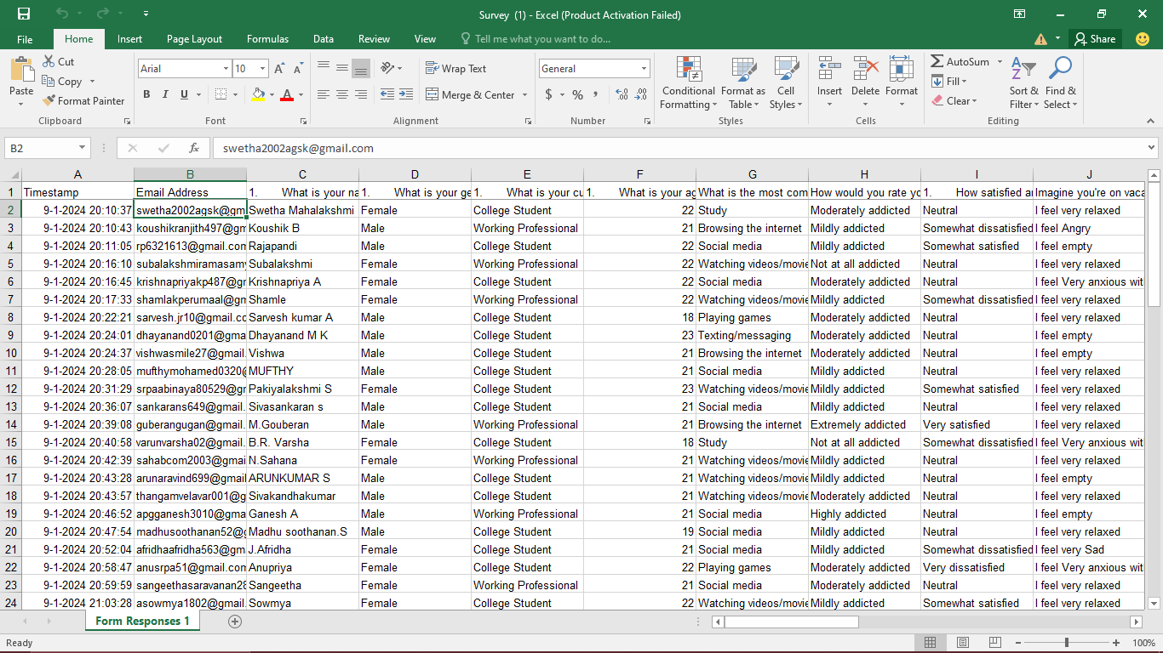
primary data excel sheet
Here I have attached our Primary data excel sheet.
Sample Image:

Slide 6
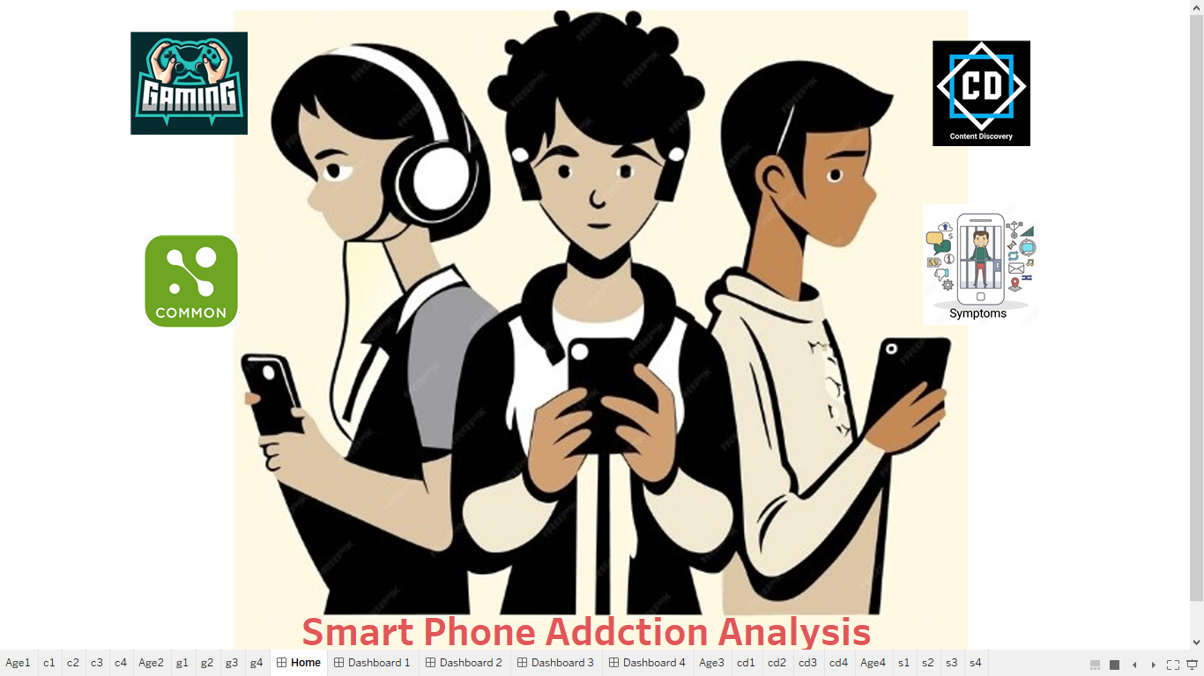
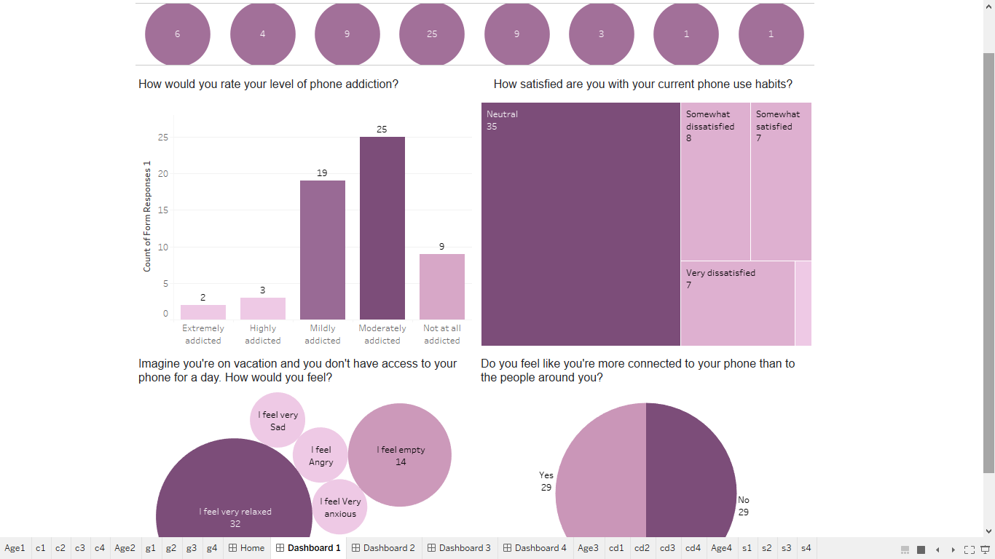
Sample Screenshot

Slide 7
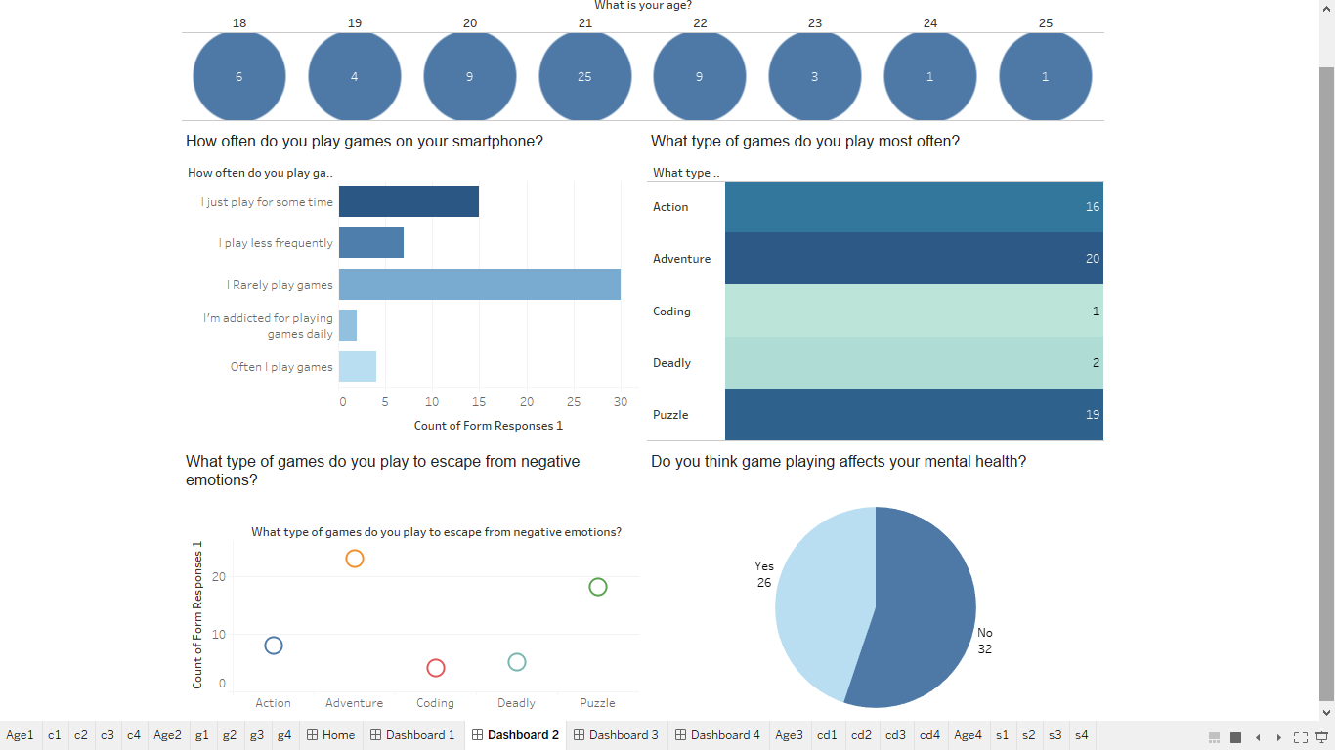
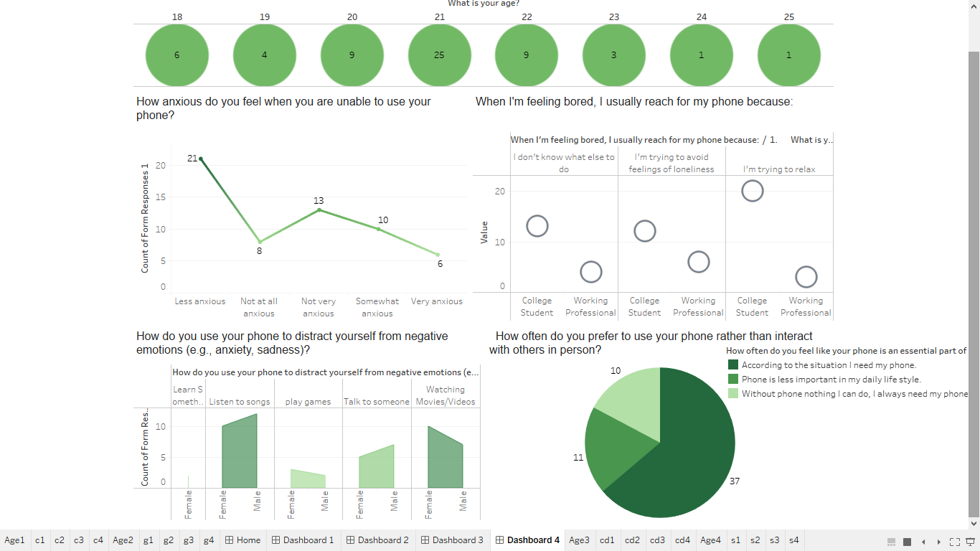

Slide 8
FINDINGS
Average Addiction Level: Most users are "Mildly addicted," showing regular, habitual smartphone use that, while not extreme, still impacts daily routines.
Most Common Health Issue: "Eye pain" is the most common health issue, likely due to extended screen time and inadequate breaks.
Average Emotion Without Phone: Users generally feel "Relaxed" when without their phones, suggesting a potential relief from the constant connectivity.
Average Daily Usage (Hours): Users spend about 3.9 hours daily on their smartphones, reflecting significant screen time integrated into daily life.

Slide 9
CONCLUSION
Through the Tableau dashboard, we gained insights such as:
Patterns of Usage: Certain age groups tend to have higher screen time and check their phones more frequently.
Health Impacts: People who use their phones excessively often report issues like anxiety, sleep problems, and difficulty focusing.
Understanding & Awareness: Visualizing data helps in recognizing smartphone addiction's impact, promoting awareness, and encouraging balanced screen time.
Increasing Dependence: Rising trends in phone-checking frequency and duration suggest growing smartphone dependency.

Slide 10
THANK YOU
Pakiyalakshmi S
Rajapandi N

